Slide 1
Employee data analysis using data
Student Name : S. Safreen
Register no : 31224942
Department : Commerce
College : Annai Veilankanni’s College for women.

Slide 2

Project title
Employee performance analysis using excel

Slide 3

Agenda
PROLEM STATEMENT PROJECT
OVERVIEW END USERS
OUR SOLUTION AND PROPOSITION
DATASET DESCRIPTION
MODELLING APPRROACH
RESULTS AND DISCUSSION
CONCLUSION

Slide 4

Problem statement
EASY DATA
MANAGEMENT DATA
ORGANANISATION
AUTOMATION
EASE OF USE VERSATILITY
COLLABORATION

Slide 5


Who are the end users
EMPLOYEES
ORGANISATION FIRM
BUSINESS
MANAGER/SUPERVISOR
HUMAN RESOURCES
CUSTOMERS

Slide 6

One solution and proposition
FILLTERING- REMOVE MISSING VALUES
CONDITIONAL FORMATTING-BLANKS
PIVOT TABLE- SUMMARY OF
EMPLOYEE PERFORMANCE
FORMULAS-IF CONDITION
GRAPHS-FINAL REPORT

Slide 7
Modelling approach
DATASET KAGGLE,EMPLOYE DATASET
• FEATURE SELECTION
• DATA CLEANING- MISSING VALUES,IRREVELENT THINGS REMOVED
• FORMULA-PERFORMANCE(LOW,MEDIUM,HIGH)
• PIVOT TABLE-SUMMARY BUSINESS,GENDER,EMPLOYEE
TYPE,EMPLOYEE ID,PERFORMANCE
• CHART-REPORT,LICENCE,

Slide 8
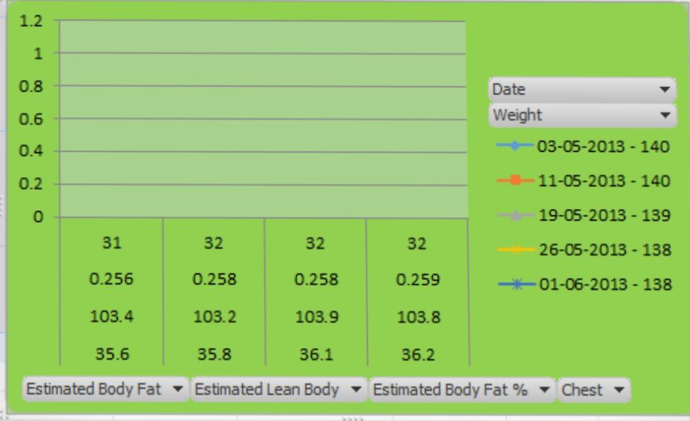
Results

Slide 9
Conclusion
_{IN THIS PRESENTATION CONCLUD ,}
• BOOST EMPLOYEE ENGAGEMENT AND
_{PRODUCTIVITY}
• OPTIMIZE TALENT DEVELOPMENT AND RETENSION
_{STRATEGIES}
• ACHIEVE A COMPETITIVEEDGE IN THE MARKET

Slide 10
Thank you

